Slide 1
Biblical Archaeology

Slide 2
Value of Archaeology: Only source of additional information
What is it? The excavation (digging up) of old remains to better understand the history and cultures of a site.
It has to be done carefully, for you destroy your evidence as you go along.
Take meticulous notes, document through photos, drawings, charts etc.
Notes:
Beyond the text of the Old and New Testament (written in Hebrew and Greek, with a little Aramaic thrown in) Archaeology gives us the only source of additional information about the Bible and its history and culture. You simply dig up the past to try and understand the various cultures of the peoples who inhabited a site over centuries. Because you destroy your evidence as you slowly dig through each level, it is paramount to document each level with photos, drawings and lots of notes.

Slide 3
Ancient cities were protected by a large outer wall. These walls caused destroyed & abandoned materials of a city to remain trapped.
Materials were reused or buried and new cities were built on top of the old ruins.
The result, after many centuries, is a “Tel” – meaning “ruin”- a big, artificial hill, which is a series of stratified levels of habitation. Most Biblical archaeology involves excavating tels.
Notes:
Because most ancient cities were surrounded by a large outer wall, every time the city was destroyed by war or an earthquake and abandoned, many of their physical materials were left behind and then another people with another culture would take over the site and build their city on top of those ruins, using some of the material from the former site and adding new buildings and materials. Then the process starts over after that city is destroyed and abandoned and another civilization builds the next level of that site. After centuries of this process you get an artificial hill called a “Tel” in the Middle East (like Tel Aviv). Tels are large mounds of centuries of ruins of many different civilizations over many different eras. Biblical archaeology is simply excavating these tells (as well as tombs and other structures near by) to try and discover what you can about the history, politics, religion and way of life of the various cultures who have lived there.

Slide 4
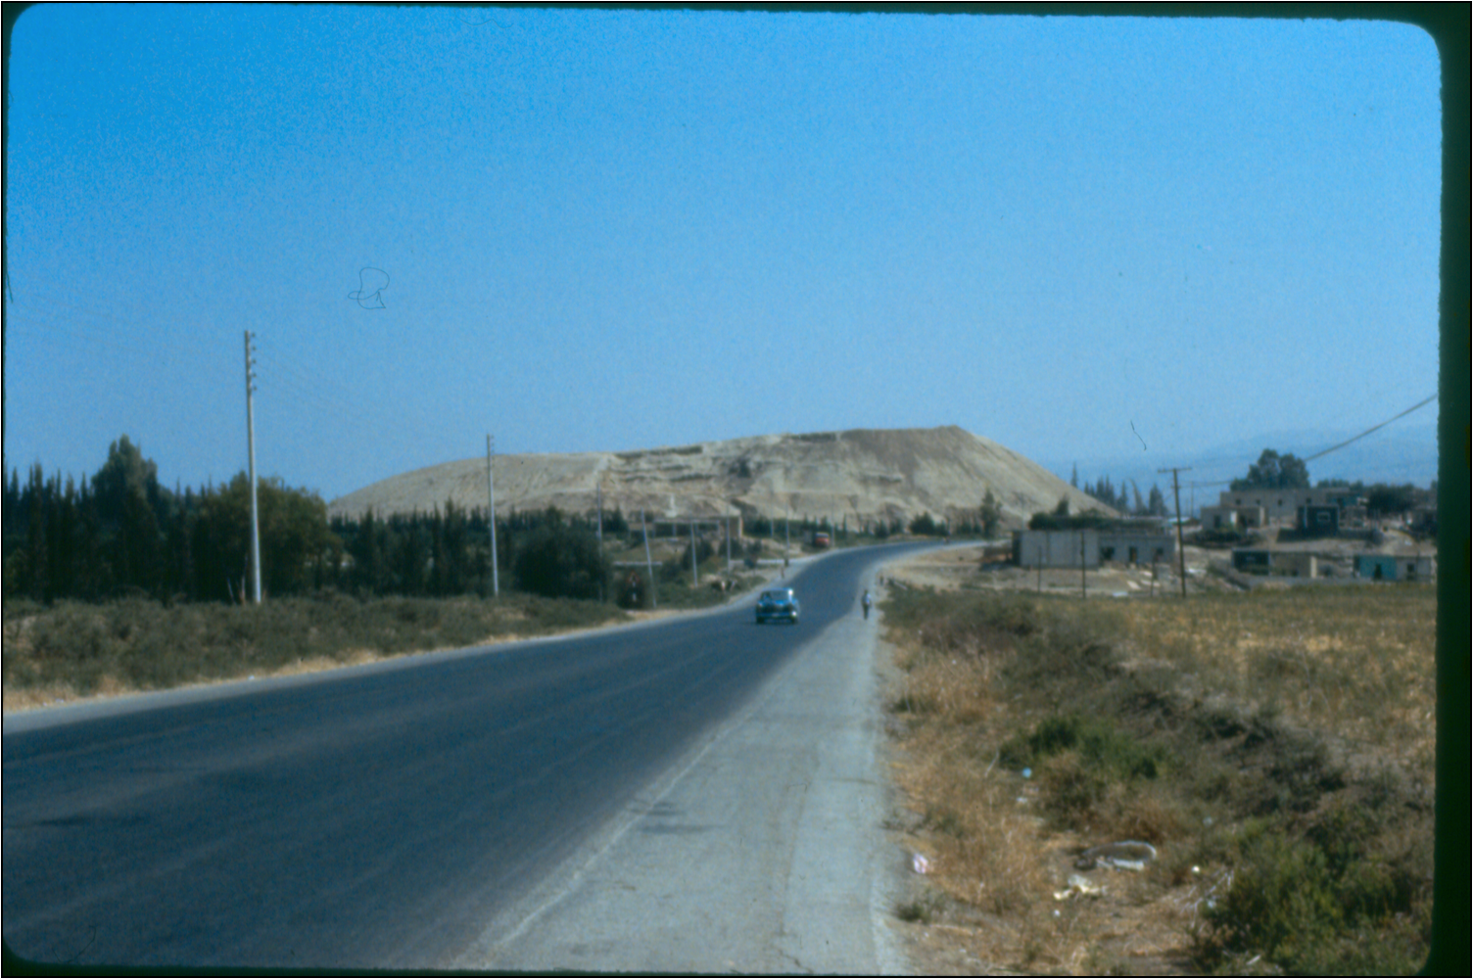
Notes:
I, Dr. Peffer, spent the summer of 1984 helping excavate an archaeological site in the country of Jordan. This is not the tel I worked on, but another one in Jordan and is a great example of what a tel looks like.

Slide 5
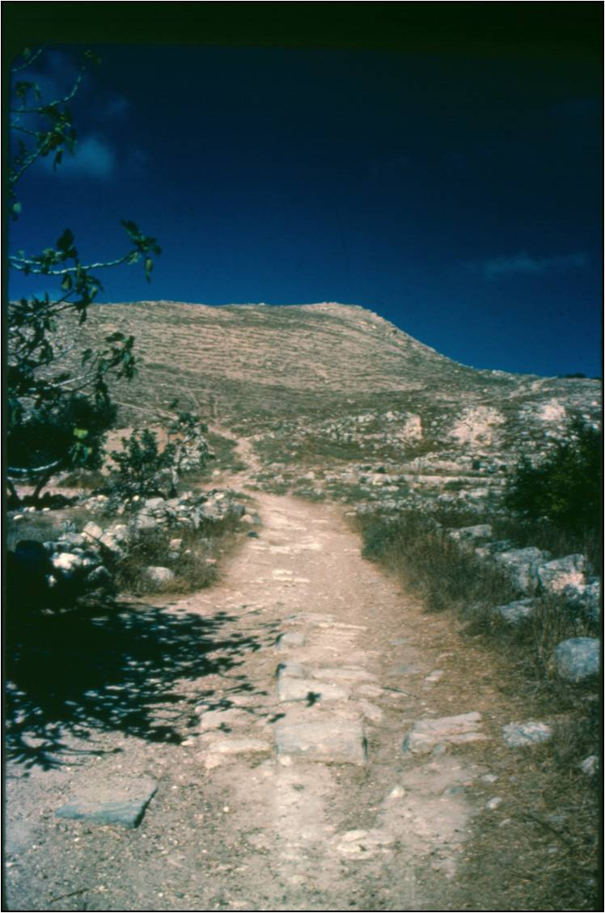
Notes:
This is Tel Abila, one of the Decapolis cities mentioned in the Bible, that I worked on. You can see the remnants of a Roman road leading up to the tel.

Slide 6
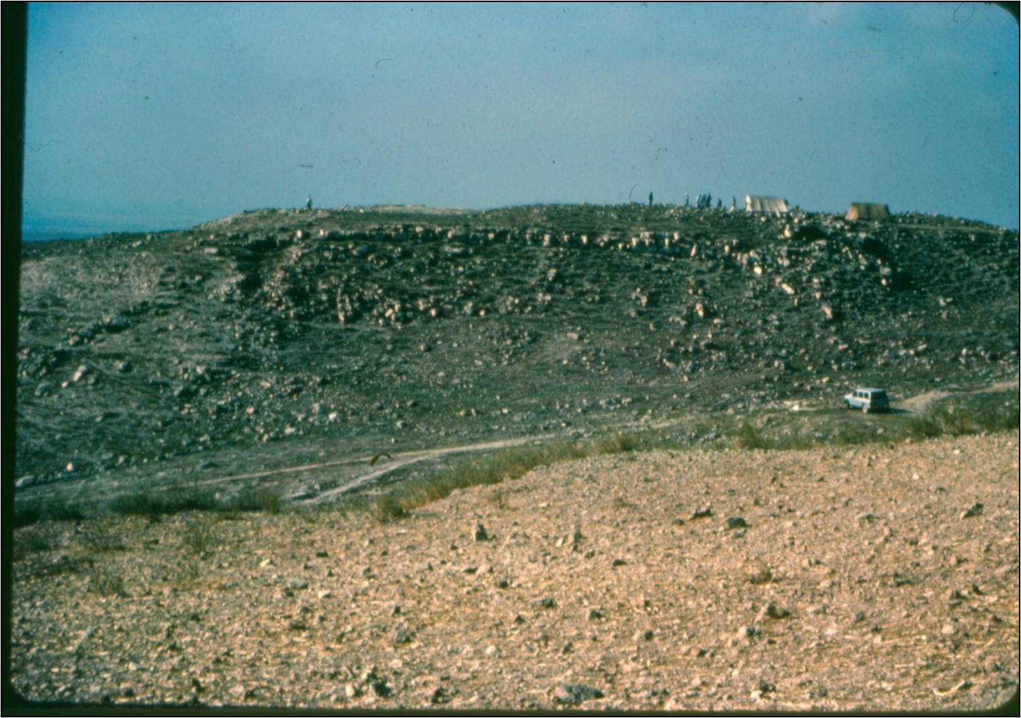
Notes:
This is a view of Tel Abila, 1984. You can see a couple of tents on the right. This is where a couple of Palestinian men stayed at night to guard our site from thieves. We also had a man guarding the tombs area, the most common sites for antiquity thieves.

Slide 7
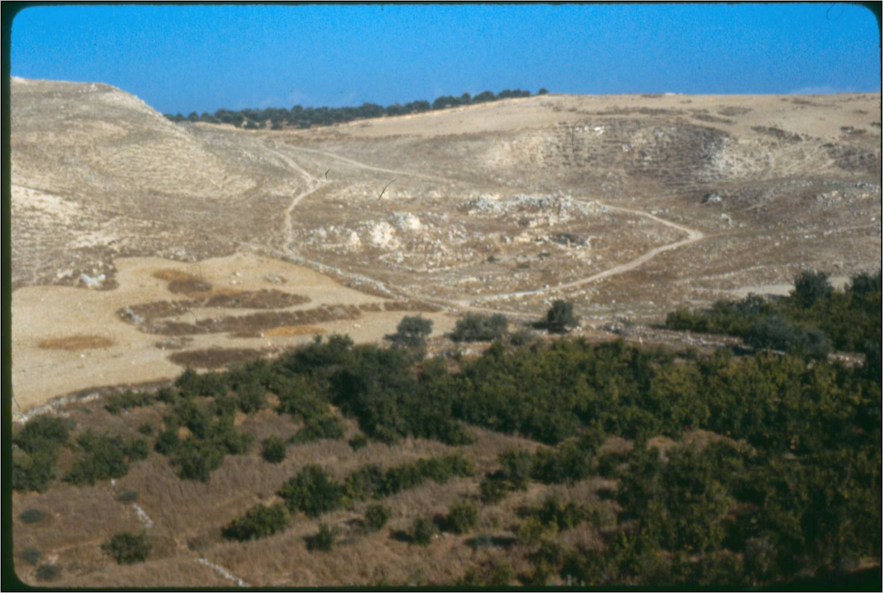
Notes:
This is a view of Tel Abila, to the left, and to the right you can still see the shape of the ancient amphitheater of Abila, where very few of the stones for the seats and stage remain.

Slide 8
3 Major Types of Excavation
A Sounding – Pick a spot, dig a hole straight down until you reach bed-rock, quickly seeing what levels of history are there.
A stepped trench – A ladder approach. You expose the levels vertically and horizontally.
Stratified Excavation – You work on the whole area at one time, starting at the top (the latest levels in history) and working down through more ancient levels.
Notes:
By far the most used way of excavating a site is by the 3rd option above – A stratified excavation. You simply divide the very top level into several 10 x 10 meter squares, marking them off with lines of string, and someone in each square uses a hand-held pick in one hand and a trowel (like for smoothing cement) in the other, and slowly and carefully breaks up the soil, looking for objects, like pottery, coins etc. You bag everything you find and label each bag by the level you are at and the date, and then you remove the soil to dumping area, one bucket at a time, where it is usually sifted through to look for small animal bones, fossils and other objects. You slowly excavate this way one level at a time and document everything as you go. Most all sites have a photographer who comes around to all the areas and documents things every day with photos. The other two ways of excavating are not used very frequently. Sometimes an the head archaeologist wants to get a quick view of what various cultures and time periods are at the site, so he/she will do a sounding, digging a much smaller area much more quickly straight down to see what is there. A stepped trench starts at the bottom and outside of a tel and moves up and in to try and get a view of what is there.

Slide 9
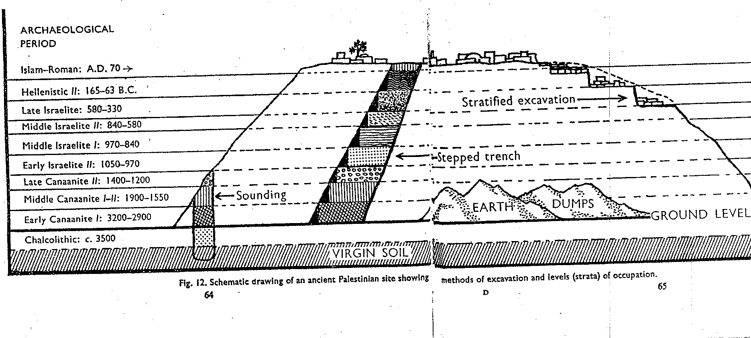
Notes:
This diagram shows you the 3 different types of excavation.

Slide 10
Archaeological Discoveries
Literature – Writing on clay tablets (cuneiform), papyrus, parchment or carvings on monuments
Notes:
The most valuable thing to find is something with writing on it, because then you can find out more about who the people were at that site at that time, and something about their history, religion, politics and culture. Writing has been found on many different mediums in the Middle East, because paper was not in used until a form of paper, papyrus, was developed in Egypt from the papyrus reeds. In ancient times people wrote on clay tablets when it was wet and then it dried out and saved the writing. Sometimes people chiseled writing on stone, like monuments; sometimes on animal skins, called parchment; and eventually on papyrus scrolls. We will see examples of these in the next slides.

Slide 11
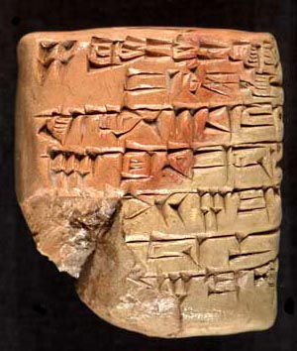
Notes:
An example of writing in cuneiform (clay tablets).

Slide 12
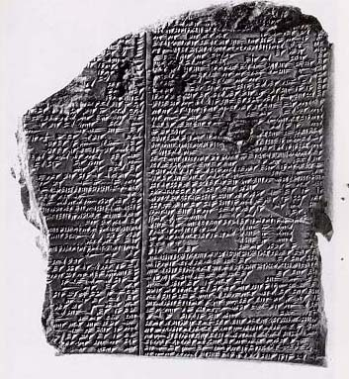
Notes:
Cuneiform tablet.

Slide 13
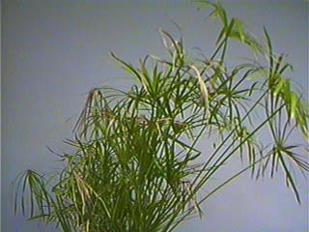
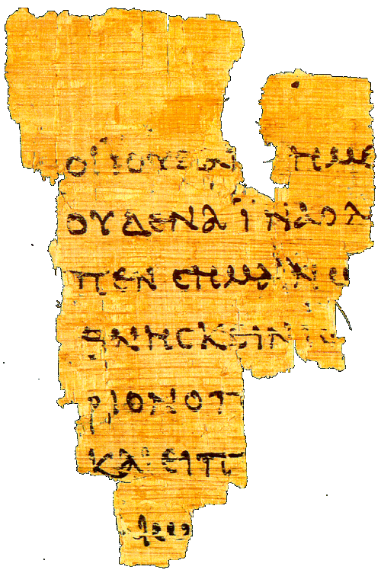
Notes:
Papyrus reeds growing near the Nile River on the left, a piece of papyrus paper with Greek writing on the right.

Slide 14

Notes:
An example of parchment or animal skins.

Slide 15
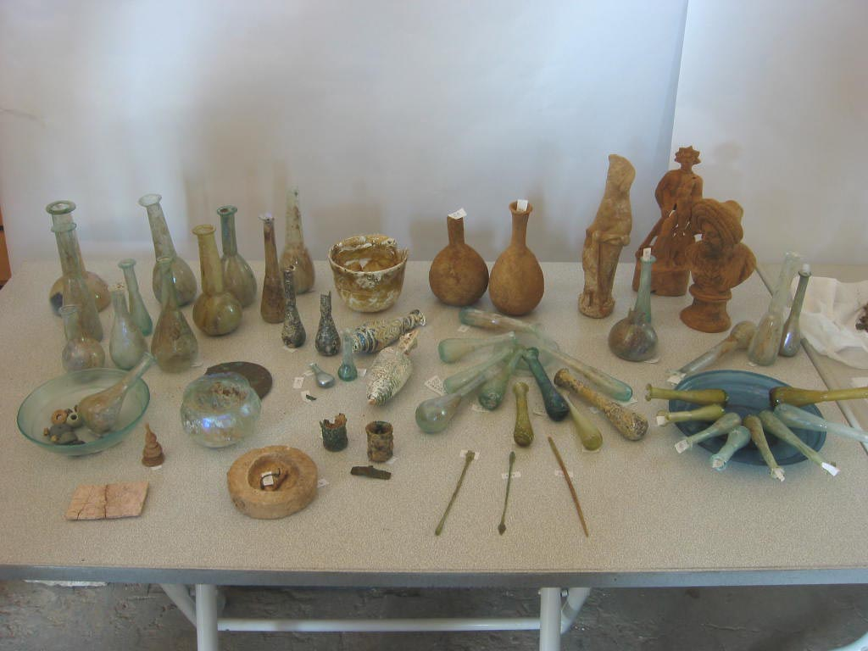
2. Physical Items
Notes:
You also find various physical items during archaeology, like tools, statues, cooking vessels and equipment, jewelry, glass bottles, and lots of oil lamps. You can do chemical and mineralogical analyses of physical items to figure out where they came from. Was the item made locally from clay in the area? Was it imported? This can tell you about trade and commerce as well as styles of the time, as well as day to day life.

Slide 16
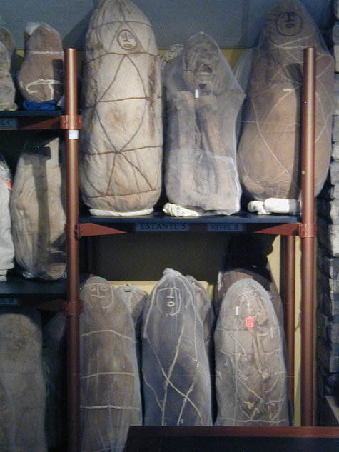
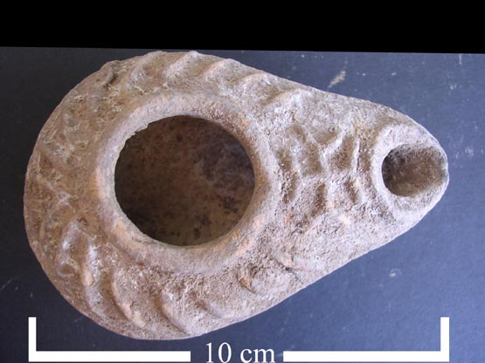
Notes:
On the left are the various “busts” found by our tomb crew in the Tel Abila dig in 1984. The tombs, especially undisturbed ones, are where you have the best chance of finding intact physical items, as people buried their dead with oil lamps, glass bottles of perfume, gold jewelry and other items. Many ancient cultures depicted their dead by drawing or carving a face into stone and placing the busts in the grave with their loved ones. To be honest, I have never heard a good explanation as to why this was done. On the right is an example of the many oil lamps we found. This one is a typical Byzantine era oil lamp (the first 3 centuries A.D.). You put the olive oil in the hole in the center and the wick comes out of the small hole at the end.

Slide 17
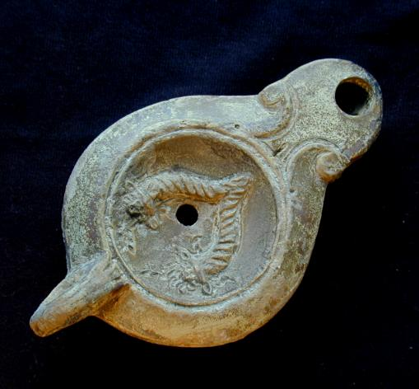
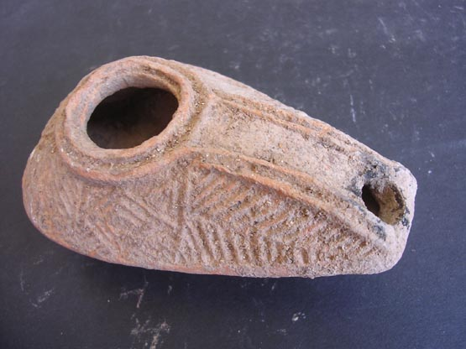
Notes:
More oil lamps.

Slide 18
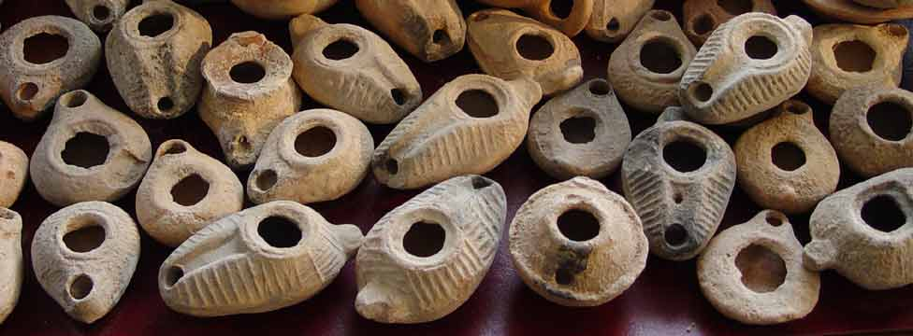

Slide 19
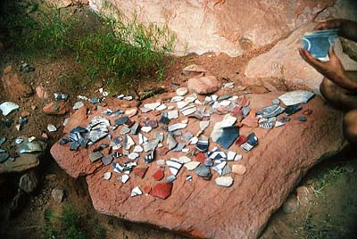
3. Pottery
Notes:
Pottery, most commonly “pot sherds” (the broken pieces of pottery that are everywhere in the Middle East), is the most important item for dating an archaeological level in Ancient Near Eastern studies. Reading the pottery is considered accurate to + or – 50 years. This is because pottery follows the laws of fashion. Just as today you can tell certain styles of cars or dress and help to date a photo, so you can date a level on a tel by what pottery pieces are found in that area. When I was doing archaeology in Jordan, one of my duties everyday, was to show up in the afternoon to my “pottery reading” in camp. When my bag of pottery was up for review for that day’s excavating, the pottery experts dumped the pot sherds on a table and quickly looked through the pieces and would read the style and say, “Byzantine” or “Hellenistic” or “Roman” or “Iron Age 2” etc. And I would write down in my notes what time period my level was at, related to the pottery. Eventually, as you move down the tel, the pottery starts to change and you then know you are in a different historical era and time period.

Slide 20
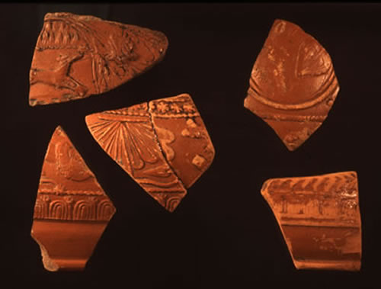
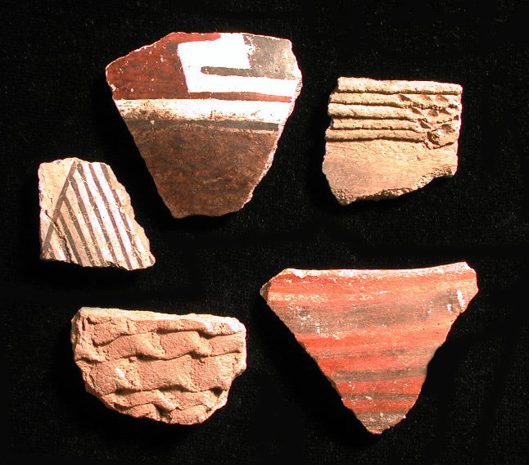
Notes:
I am not sure what era the pot sherds are from on the left (it may be Hellenistic/Greek) but on the right those are definitely pieces from the Roman period (classic Roman terra cotta pottery).

Slide 21
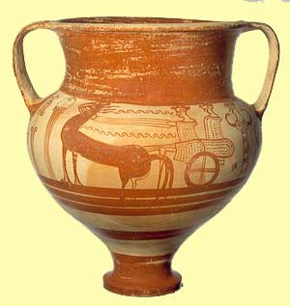
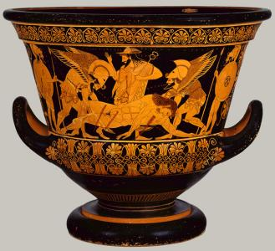
Notes:
Examples of Hellenistic era pottery.

Slide 22
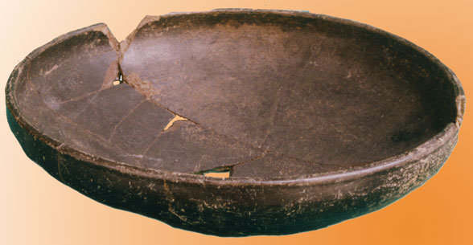
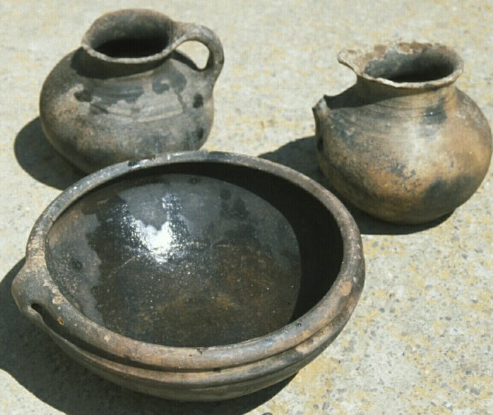
Notes:
The older the pottery is, the less ornate it is. These vessels, I believe, are from the Iron age.

Slide 23
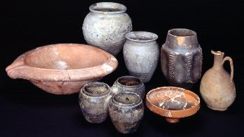

Slide 24
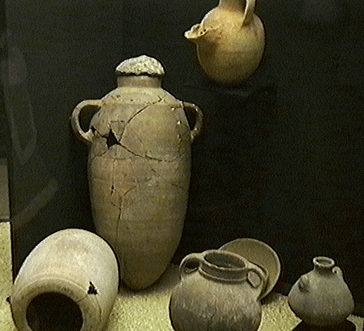
Notes:
Ancient pottery from a site in Jericho. I believe these are from the Early or Middle Bronze age.

Slide 25
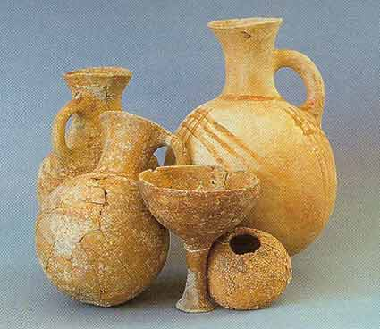

Slide 26
Pottery follows the laws of fashion and is the most important item for dating in Near Eastern Studies.
Reading Pottery for dating is accurate to within plus or minus 50 years.
Carbon 15 Dating has some discrepancies, and since it dates carbon, you have to find something that used to be living to do this (wood etc.), which is unusual to find in these excavations. Also, wood etc. can be moved and used by one culture to the next.

Slide 27
4. Building Remains
Walls, gates, aqueducts etc.
You can date a buildings remains by the pottery
By these remains you can learn about the people’s religion, politics, living conditions etc.
Notes:
You can also tell a lot about a site from its building remains. How was the society structured? Was their religion important? How did they live, work, cook, recreate, etc.

Slide 28
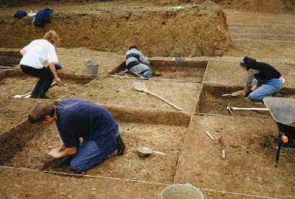
Notes:
Here you see the classic way of doing a stratified excavation, 10 x 10 meter squares, kneeling in the dirt, slowly moving through the soil to see what is there.

Slide 29
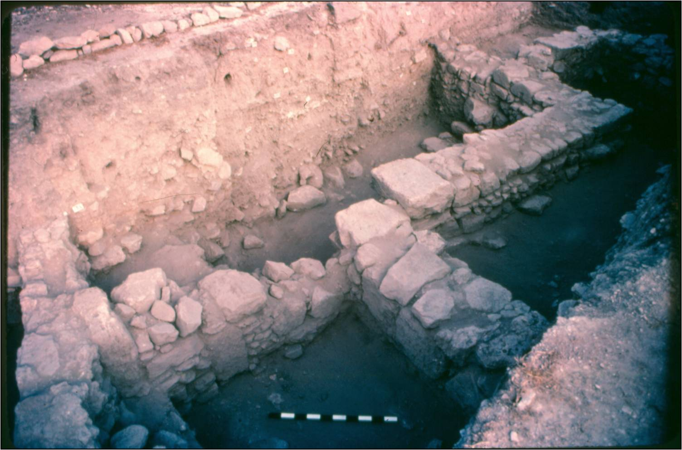
Notes:
Parts of walls in the main tel of Tel Abila, 1984.

Slide 30
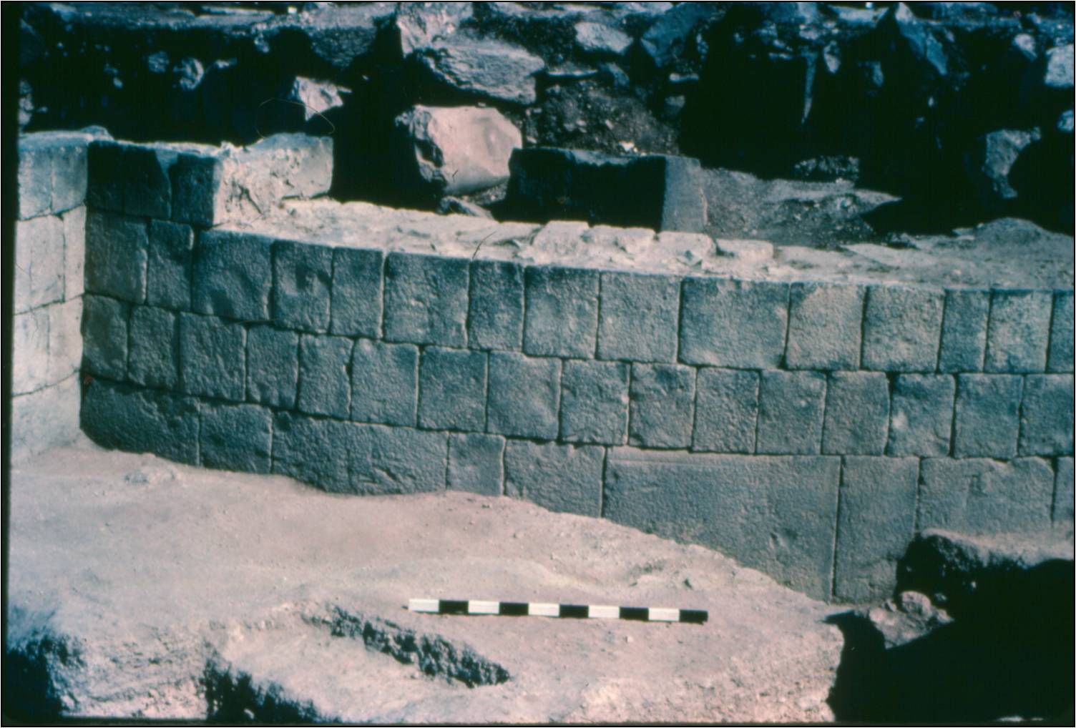
Notes:
Part of the apse of a 1st century church (Basilica) at the main tel of Tel Abila, 1984.

Slide 31
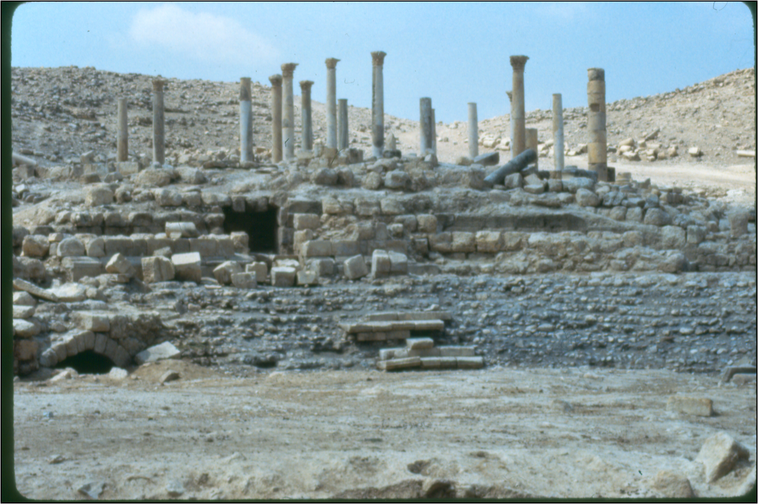
Notes:
Some of the ruins of the Jerash site in Jordan that I visited in 1984.

Slide 32
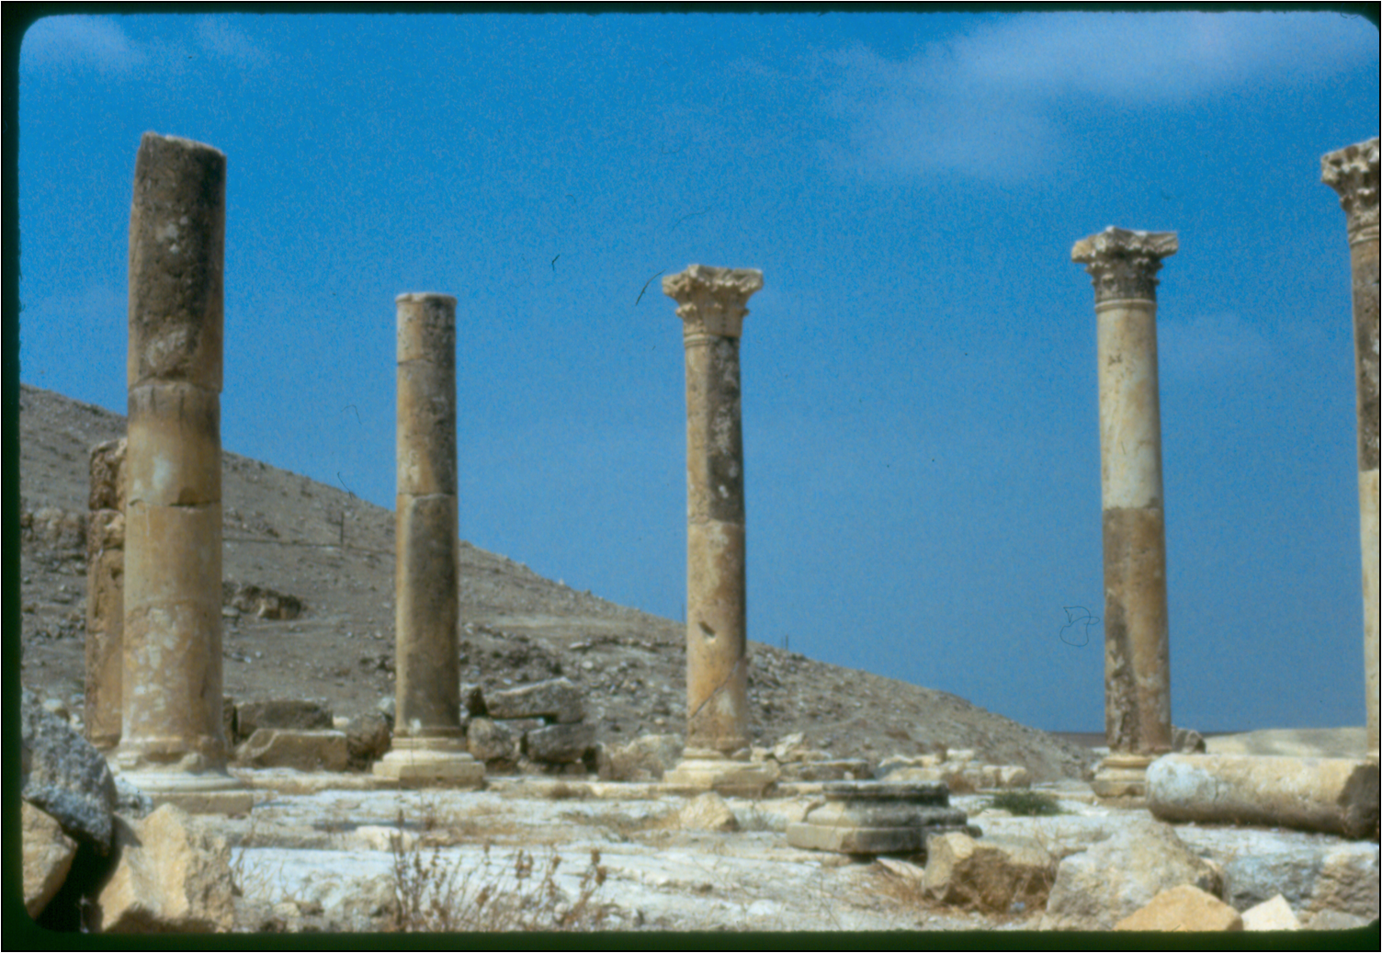
Notes:
Jerash

Slide 33
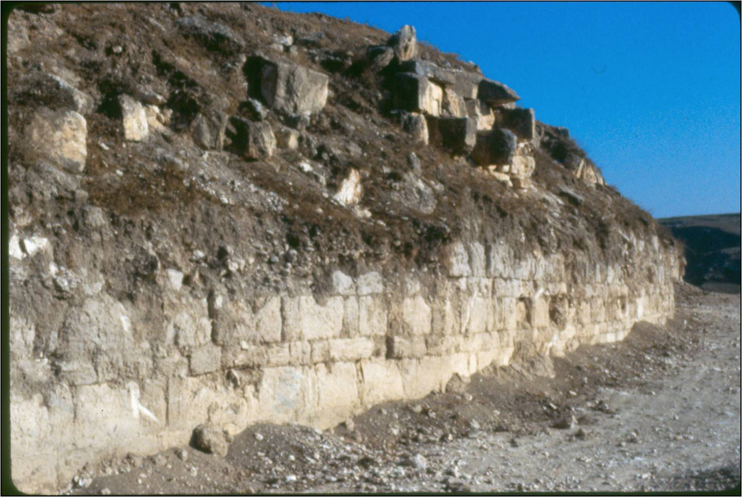
Notes:
The outer wall exposed at Tel Abila, where I excavated in 1984.

Slide 34
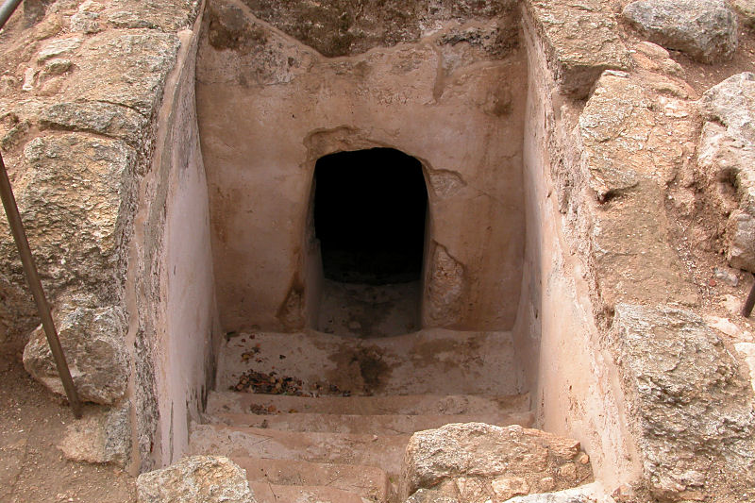
Notes:
An example of a tomb entrance in the Middle East. All of the entrances are initially buried under centuries of soil, but when you find them, you slowly remove all of the soil and enter the tombs for excavation. We had a paleontologist as part of our crew to study the skeletal remains.

Slide 35
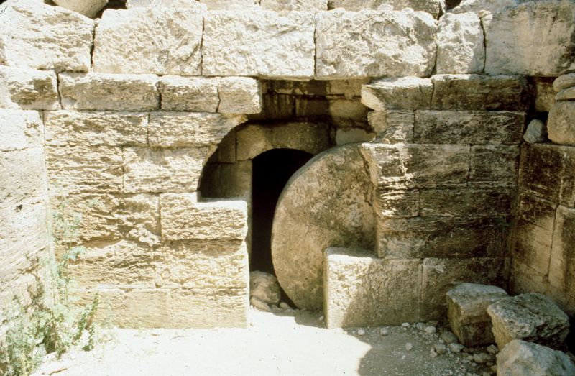
Notes:
A classic tomb in the Ancient Near East. Families or clans would dig out a cave and place their dead in side rooms dug out in the cave, or in sarcophagi (if they were wealthy), or just on a stone slab. After each burial, since the buried many people in one tomb, they often sealed it off with a cut stone, like you see here, and like is documented at Jesus’ tomb.

Slide 36
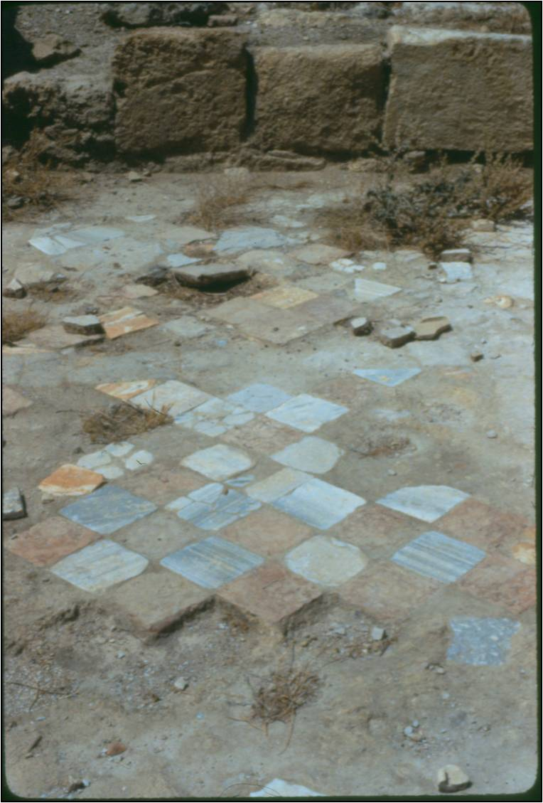
Notes:
Beautiful cut, colored stones that were part of the floor of the area I was excavating away from the main tel, on a secondary site close by. We were the first people to ever excavate the area, which was around many columns that had fallen centuries ago because of an earthquake. The structure we were working on was probably an 1st century Christian church.

Slide 37
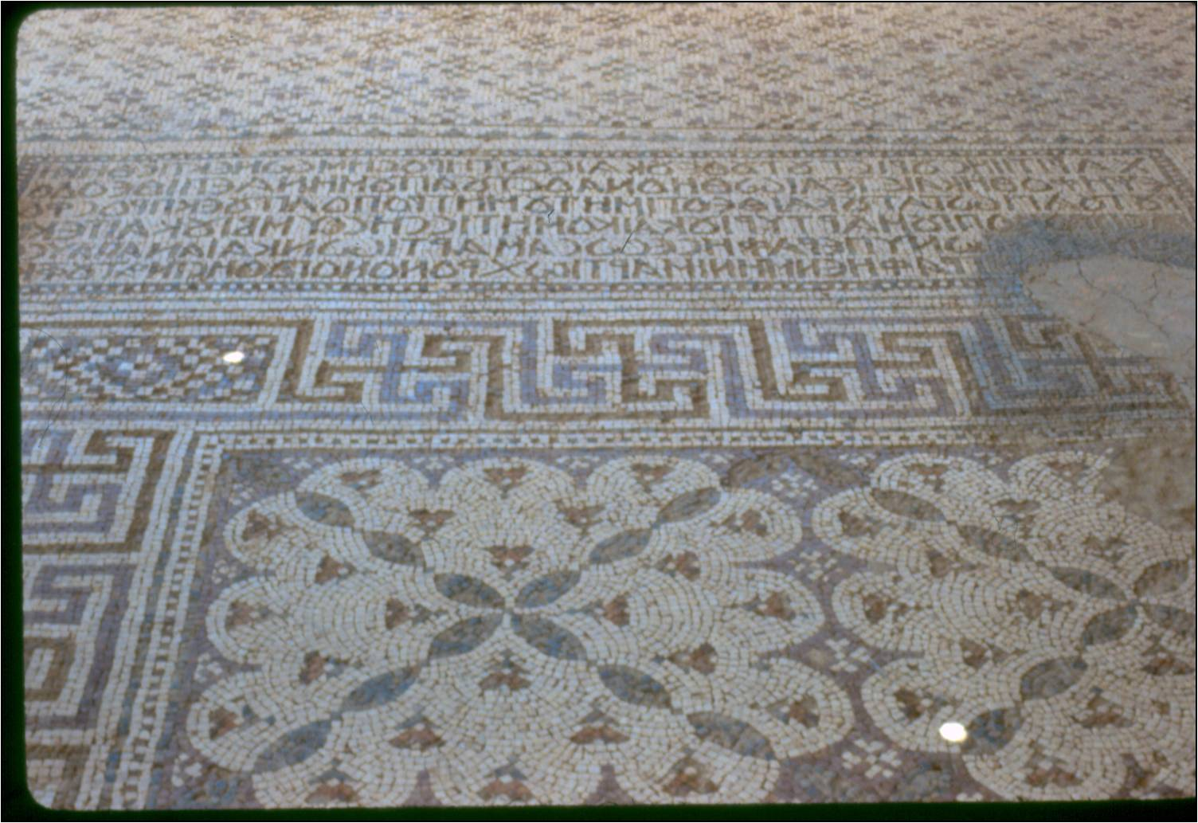
Notes:
A beautiful mosaic floor that my crew visited at some ancient site somewhere in the desert on a road going toward Iraq. You can see Greek writing.

Slide 38
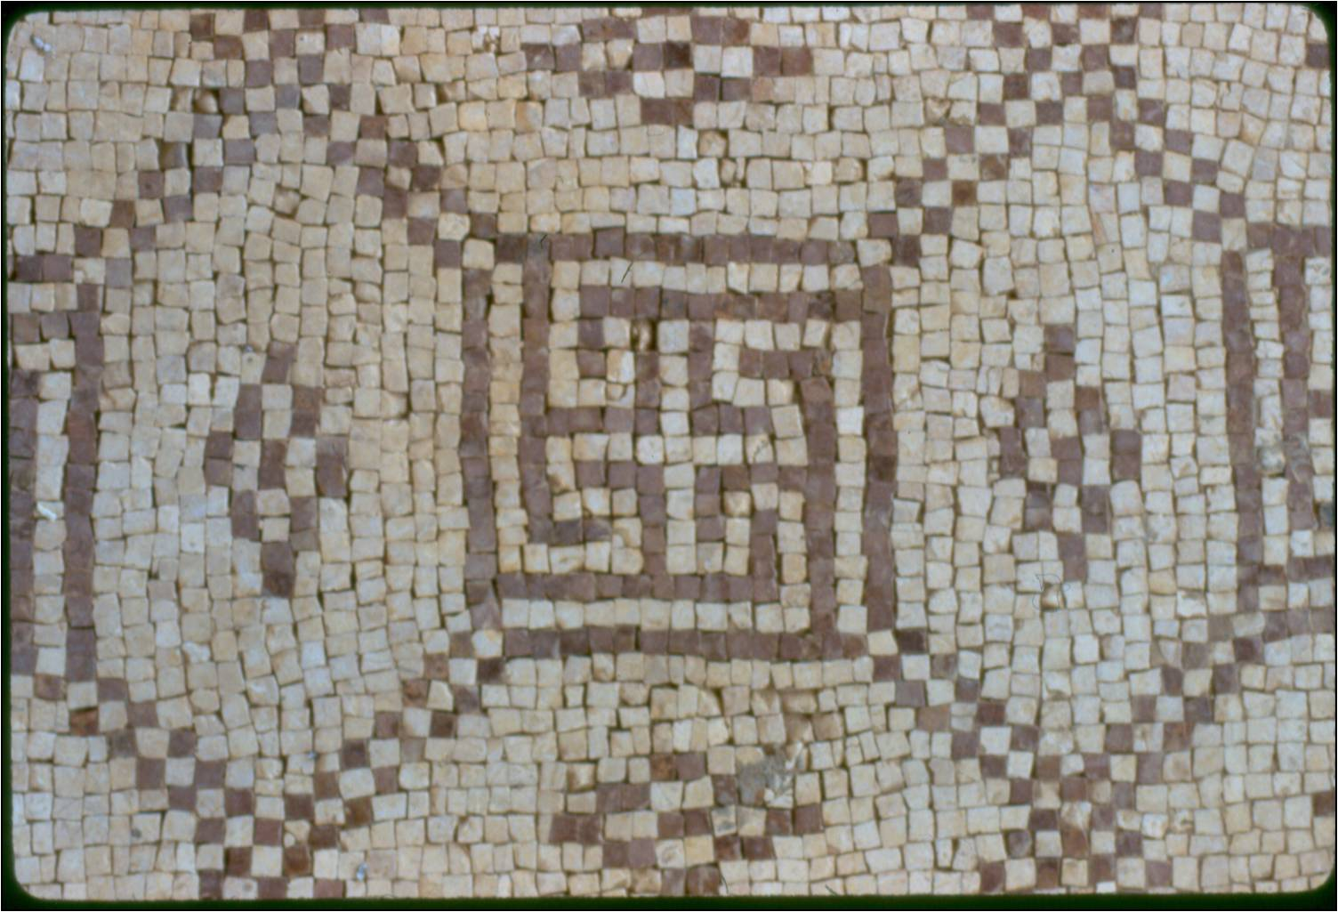

Slide 39
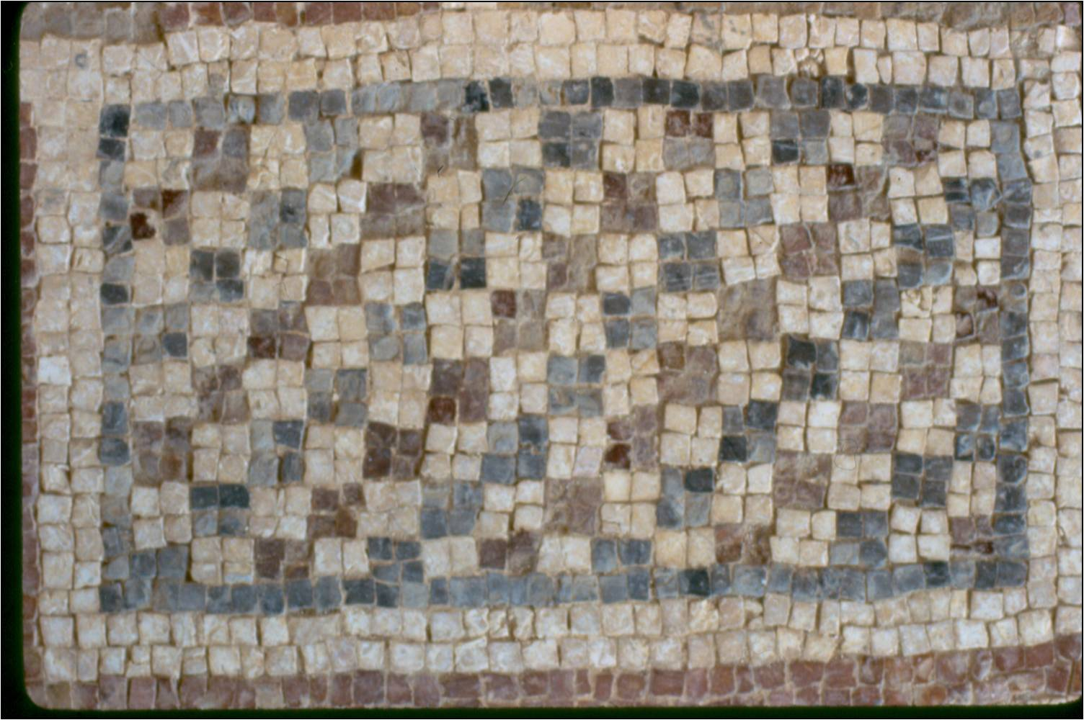

Slide 40
The Bible in History
2,000 BC Abraham
3,000 BC Writing Invented
5,000 BC Pottery Invented
7,000 BC Neolithic Jericho
10,000 BC Last Ice Age
250,000 BC (?) Stone Age

Slide 41
Where archaeology intersects with Biblical History it tends to be very favorable to the Bible, i.e. names of cities, kings, neighbors. It supports the Bible’s history & stories.
If I am willing to accept the secular scientific means of archaeology to support & understand Scripture, I need to be open to accept what archaeology says about other time periods and places outside the Biblical history.

Slide 42
Biblical history is NOT at the dawn of human civilization, but late.
Abraham was rural, but not primitive; he was interacting with a complicated world of governments, laws, commerce, languages, treaties etc.
The Biblical story is late in the history of humanity, but this does not falsify anything in the Bible; it assumes all these other cultures

